Slide 1
Unit 2
STRUCTURE OF PROTEINS

Slide 2
Proteins
Proteins are polymers (macromolecules) made of monomers called amino acids
All proteins are made of 20 different amino acids linked in different orders
Proteins are used to build cells, act as hormones & enzymes, and do much of the work in a cell
Arginine
2
Notes:
2
Essential Amino Acids= PVT TIM HALL

Slide 3
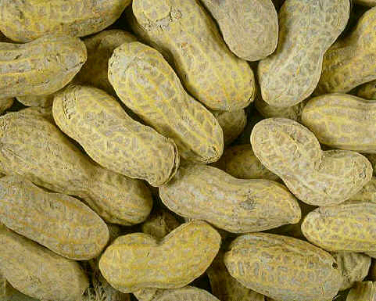
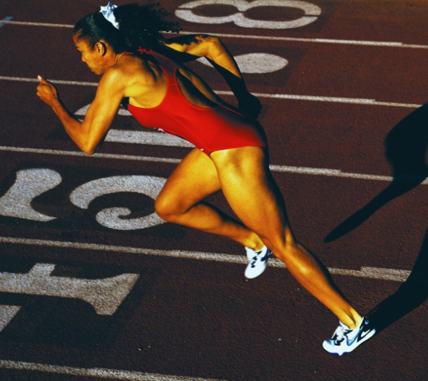
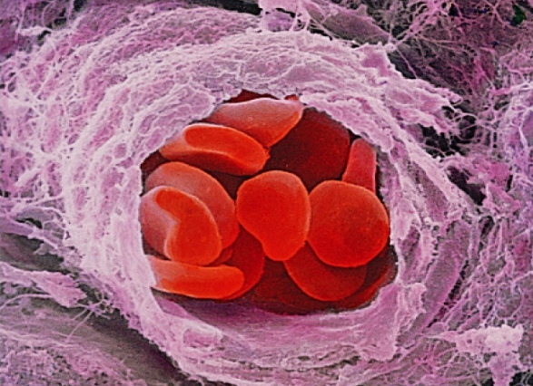
Protein Functions in the Body
Storage
There are many different proteins in your body, and they perform different functions. Proteins functions include:
Contributing to enzyme activity that promotes chemical reactions in the body
Signaling cells what to do and when to do it
Transporting substances around the body
Keeping fluids and pH balanced in the body
Serving as building blocks for hormone production
Helping blood clot
Promoting antibody activity that controls immune and allergy functions
Serving as structural components that give our body parts their shapes
Structural
Transport

Slide 4
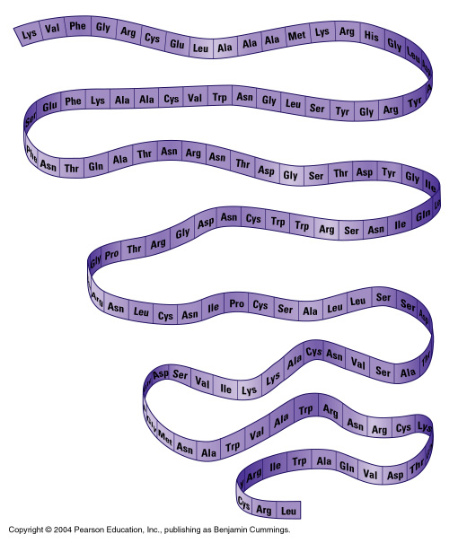
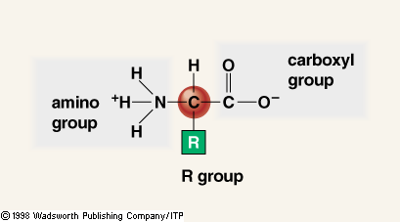
Primary Protein Structure
The primary structure is the specific sequence of amino acids in a protein
Called polypeptide
Amino Acid
4
Notes:
4

Slide 5
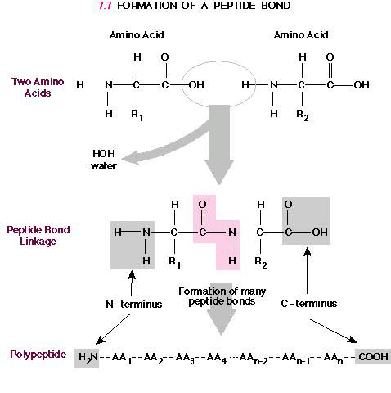
Protein Structures
Peptide Bonds
Secondary protein structures occur when protein chains coil or fold
When protein chains called polypeptides join together, the tertiary structure forms because R groups interact with each other
In the watery environment of a cell, proteins become globular in their quaternary structure
5
Notes:
5

Slide 6
Protein Conformation
Conformation (shape) determines function and is the result of the linear sequence of amino acids in a polypeptide.
Folding, coiling and the interactions of multiple polypeptide chains create a functional protein
4 levels of conformation
Primary
Secondary
Tertiary
Quartinary

Slide 7
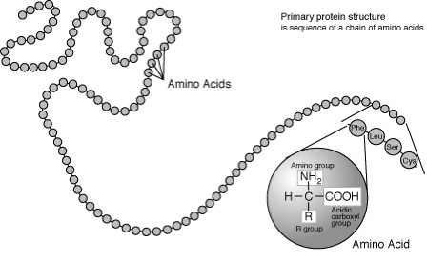
Primary Structure
Unique, linear sequence of amino acids in a protein
A change in one a.a. can effect every other level of structure
ex. point mutation in hemoglobin

Slide 8
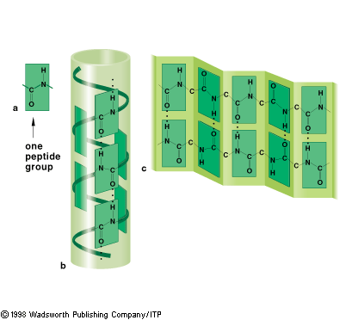
Secondary Structure
Hydrogen bonding occurs between amino and carbonyl groups of amino acids.
Structures Formed:
α Helix: Common in fibrous proteins, creates “elastic” properties.
β Sheet: Anti-parallel chains form sheet.

Slide 9
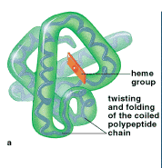
Tertiary Structure
Irregular contortions from bonding between side chains of various amino acids
9

Slide 10
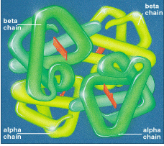
Quaternary Structure
Overall protein structure that results from aggregation of tertiary subunits

Slide 11
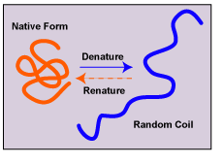
Denaturation
Unraveling and loss of native conformation of a protein
Can be due to heat, pH, salts, etc.
Some can renature exactly, others cannot
Ex: cooking an egg

Slide 12
Protein Synthesis
DNA unwinds
mRNA copy is made of one of the DNA strands.
mRNA copy moves out of nucleus into cytoplasm.
tRNA molecules are activated as their complementary amino acids are attached to them.
mRNA copy attaches to the small subunit of the ribosomes in cytoplasm. 6 of the bases in the mRNA are exposed in the ribosome.
A tRNA bonds complementarily with the mRNA via its anticodon.
A second tRNA bonds with the next three bases of the mRNA, the amino acid joins onto the amino acid of the first tRNA via a peptide bond.
The ribosome moves along. The first tRNA leaves the ribosome.
A third tRNA brings a third amino acid
Eventually a stop codon is reached on the mRNA. The newly synthesised polypeptide leaves the ribosome.

Slide 13
Translation
Synthesis of proteins in the cytoplasm
Involves the following:
1. mRNA (codons)
2. tRNA (anticodons)
3. ribosomes
4. amino acids
Three steps:
1. initiation: start codon (AUG)
2. elongation: amino acids linked
3. termination: stop codon (UAG, UAA, or UGA).

Slide 14
mRNA Codons Join the Ribosome
Large
subunit
P
Site
A
Site
mRNA
A
U
G
C
U
A
C
U
U
C
G
Small subunit

Slide 15
Initiation
aa2
aa1
2-tRNA
1-tRNA
G
A
U
anticodon
U
A
C
hydrogen
bonds
A
U
G
C
U
A
C
U
U
C
G
A
codon
mRNA
Notes:
15
15

Slide 16
Elongation
peptide bond
aa3
aa1
aa2
3-tRNA
G
A
A
1-tRNA
2-tRNA
anticodon
U
A
C
G
A
U
hydrogen
bonds
A
U
G
C
U
A
C
U
U
C
G
A
codon
mRNA

Slide 17
aa1
peptide bond
aa3
aa2
1-tRNA
U
A
C
3-tRNA
(leaves)
G
A
A
2-tRNA
G
A
U
A
U
G
C
U
A
C
U
U
C
G
A
mRNA
Ribosomes move over one codon

Slide 18
peptide bonds
aa1
aa4
aa2
aa3
4-tRNA
G
C
U
2-tRNA
3-tRNA
G
A
U
G
A
A
A
U
G
C
U
A
C
U
U
C
G
A
A
C
U
mRNA

Slide 19
peptide bonds
aa1
aa4
aa2
aa3
2-tRNA
4-tRNA
G
A
U
(leaves)
G
C
U
3-tRNA
G
A
A
A
U
G
C
U
A
C
U
U
C
G
A
A
C
U
mRNA
Ribosomes move over one codon

Slide 20
peptide bonds
aa5
aa1
aa2
aa4
aa3
5-tRNA
U
G
A
3-tRNA
4-tRNA
G
A
A
G
C
U
G
C
U
A
C
U
U
C
G
A
A
C
U
mRNA

Slide 21
peptide bonds
aa5
aa1
aa2
aa3
aa4
5-tRNA
3-tRNA
U
G
A
G
A
A
4-tRNA
G
C
U
G
C
U
A
C
U
U
C
G
A
A
C
U
mRNA
Ribosomes move over one codon

Slide 22
aa5
aa4
aa199
Termination
aa3
primary
structure
of a protein
aa200
aa2
aa1
terminator
or stop
codon
200-tRNA
A
C
U
C
A
U
G
U
U
U
A
G
mRNA

Slide 23
End Product –The Protein!
The end products of protein synthesis is a primary structure of a protein
A sequence of amino acid bonded together by peptide bonds
aa5
aa4
aa3
aa2
aa199
aa1
aa200
23
Notes:
23
23

Slide 24
Eukaryotic Protein Synthesis Differs from Prokaryotic Protein Synthesis Primarily in Translation Initiation
The basic plan of protein synthesis in eukaryotes and archaea is similar to that in bacteria.
Eukaryotic protein synthesis entails more protein components than does prokaryotic protein synthesis, and some steps are more intricate.
1. Ribosomes.
Eukaryotic ribosomes are larger: consist of a 60S large subunit and a 40S small subunit, which come together to form an 80S particle having a mass of 4200 kd,
40S subunit contains an 18S RNA
60S submint contains 5S, 5.8S, and 28S
Prokaryotic ribosomes have small (in E. coli , 30S) and larger (50S) subunits.
The 30S unit has 16S rRNA and 21 different proteins.
The 50S subunit consists of 5S and 23S rRNA and 34 different proteins.

Slide 25
2. Initiator tRNA. In eukaryotes, the initiating amino acid is methionine rather than N-formylmethionine. However, as in prokaryotes, a special tRNA participates in initiation. This aminoacyl-tRNA is called Met-tRNAi or Met-tRNAf (the subscript “i” stands for initiation, and “f” indicates that it can be formylated in vitro).
3. Initiation. The initiating codon in eukaryotes is always AUG. In contrast, a prokaryotic mRNA can have multiple start sites, and it can serve as a template for the synthesis of several proteins. Eukaryotes utilize many more initiation factors than do prokaryotes, and their interplay is much more intricate.
4. Elongation and termination. Eukaryotic elongation factors EF1α and EF1βγ are the counterparts of prokaryotic EF-Tu and EF-Ts.
Termination in eukaryotes is carried out by a single release factor, eRF1, compared with two in prokaryotes. Finally, eIF3, like its prokaryotic counterpart IF3, prevents the reassociation of ribosomal subunits in the absence of an initiation complex.

Slide 26
Proteins in our body
Keratin in Hair
DNA, RNA polymerases
Catalase
Lactase
Glucosidase
Lipase
Protease
RNase
DNase etc.

